Slide 1






HealthMate – Mobile Application
A Privacy-First Health Companion For Chronic Conditions
Name: T.A.M.I. Dayarathna
Reg No: 421460186

Slide 2




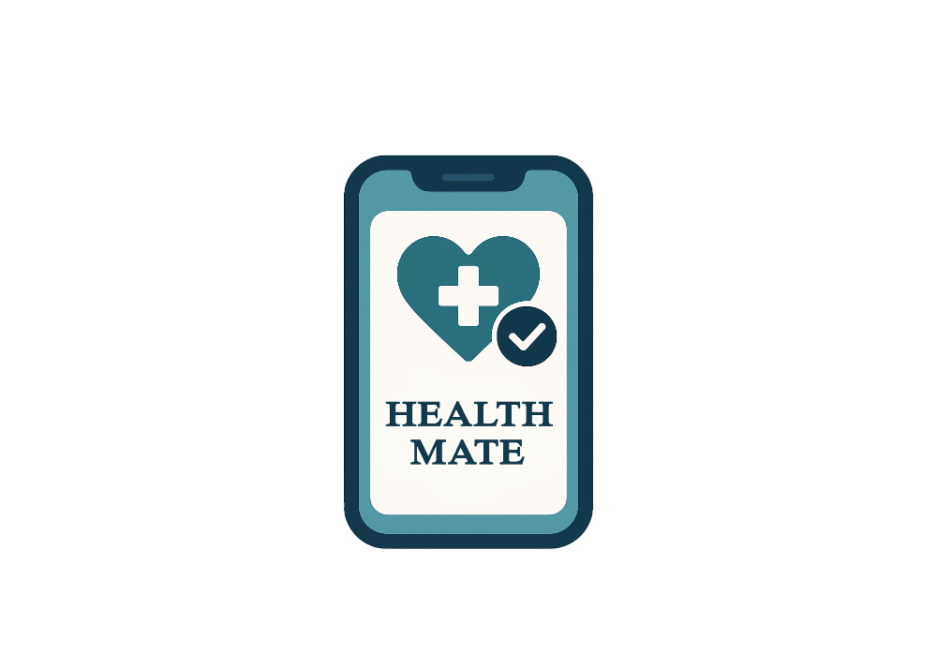
Overview
01
01
Introductin
02
02
Problem
03
03
Aim
04
04
Objectives
05
Specific Features
06
Methodology
07
Proposed Approaches
08
Resource Requirements
09
Time Schedule

Slide 3


Introduction
In Sri Lanka, Chronic diseases like diabetes and hypertension are on rise.
Patients with chronic conditions face daily challenges in tracking health medications.
Current methods (memory, paper logs, insecure apps) lead to errors and poor adherence.
Patients have major concerns about the security and privacy of their health data.
“HealthMate” is a privacy-first mobile app to support patients.
It provides digital care plans, secure health logging, reminders and AI-powered suggestions.

Slide 4
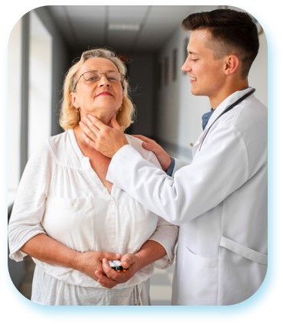



Problem
Lack of a simple digital daily care plan.
Inaccurate & inefficient manual tracking.
Ineffective doctor visits due to poor history visibility.
Patients often forget to take their medications on time.
Data privacy concerns with existing apps.

Slide 5




Aim
To develop a AI-based automated solutions and
privacy-focused mobile app that helps Sri Lankan users
manage chronic conditions that enabling personalized plans, secure tracking, AI-powered suggestions and doctor-friendly reports.

Slide 6






Objectives
To Review existing digital health apps to identify gaps in privacy, usability and personalization.
To analyze user challenges in chronic conditions management in Sri Lanka.
To design a My Care Plan (MCP) for setting health goals, medication schedules and daily tracking.
To develop a secure system with AI-driven support and personalized guidance.
To provide clear health data visualization and exportable reports for users and healthcare providers.
To test the application for functionality, usability and security.

Slide 7



Specific Features
User Authentication & Profiles – Secure login and personalized health profile setup.
My Care Plan (MCP) – Structured daily plan with goals, medications and routines.
Health Data Logging – Record vital signs, symptoms and lifestyle metrics.
Reminders & Tips – AI-powered notifications to encourage adherence.
Data Visualization – Charts and graphs to track health progress over time.
Report Generation PDF/CSV – Exportable reports like PDF for doctor consultations.
Privacy-First Storage – Local encrypted data with anonymous cloud insights.

Slide 8
Methodology
The project follows an Agile-based development approach
Phase | Duration | Key Tasks | Deliverables
Sprint 0: Planning & Setup | Weeks 1-2 | - Requirement gathering - UI/UX & system design - Privacy & risk check | - Final requirements - UI/UX Wireframes & Sys architecture - Risk/privacy report
Month 1: Foundations | Weeks 3-6 | - Foundation setup - Secure local data storage - User authentication - My Care Plan | - SQLite storage - Basic Authentication - MCP goals & meds
Month 2: Personalization & Discovery | Weeks 7-10 | - Health data logging - Data visualization - AI reminders & tips | - Logging interface - Dashboards - AI reminders
Month 3: Testing & Launch | Weeks 11-14 | - Reporting & export features - Testing - Legal documentation - MVP Deployment | - CSV/PDF health reports - Privacy & disclaimer - Tested MVP - Play Store release

Slide 9


Proposed Approaches
MVP-First Strategy – Focus on essential features like My Care Plan, health logging, reminders and reports.
Hybrid AI Setup – Use on-device AI for privacy and cloud AI for advanced suggestions.
Privacy by Design – Keep raw health data on the user’s device.
Modular Architecture – Separate mobile app, backend, AI services and databases for scalability.
Continuous Testing – Regular checks for security, usability and performance.
User-Centered Feedback – Get feedback from patients and doctors.

Slide 10

Resource Requirements
Software : React Native with Expo Go, Java Spring Boot
Python , Firebase Firestore, Neo4j , LangChain , Libraries for PDF/CSV export
Hardware : Development computer, Android smartphone for testing, Servers for backend hosting, Cloud instances for development & testing
Human Resources : Mobile App Developer, Backend Developer, AI/ML Specialist, UI/UX designer, Database Administrator, QA Tester

Slide 11





Time Schedule
Task Name |  | 2025
 |  | Aug | Sep | Oct | Nov | Dec | Jan | Feb
1 | Proposal writing online workshop
2 | Project proposal submission
3 | Project proposal evaluation
4 | Notify the selection
5 | Requirement gathering. Literature Survey Progress Report Submission.
6 | Chapter 1 – Introduction background of the problem draft report submission
7 | Draft report of chapter 2 - Literature Review - Progress Report Submission
8 | Draft report of chapter 3 – Research Methodology Progress Report Submission
9 | Data Collection Project Implementation
10 | Draft Report of chapter 4 – (Data Analysis of Implementation and evaluation)
11 | Draft report of chapter 5 - Conclusion and recommendation progress report submission
12 | Final submission and Viva

Slide 12



Reference Resources
1. Academic & Research Papers
World Health Organization (2022). Noncommunicable Diseases in Sri Lanka. WHO Country Office.
Parliament of Sri Lanka (2022). Personal Data Protection Act, No. 9 of 2022.
2. Regulations & Compliance Guidelines
Sri Lanka PDPA (Personal Data Protection Act) – https://www.pdpa.gov.lk
WHO Guidelines on NCD Management – https://www.who.int
HIPAA (Health Insurance Portability & Accountability Act, US) – https://www.hhs.gov/hipaa
3. Industry Reports & Case Studies
Deloitte (2023). Digital Health Trends & Patient Data Privacy.
PwC (2022). The Future of Health Apps in Emerging Markets.
4. Technology & Tools
React Native Documentation – https://reactnative.dev/docs
Spring Boot Documentation – https://spring.io/projects/spring-boot
Firebase Documentation – https://firebase.google.com/docs
Neo4j Graph Database – https://neo4j.com/docs
LangChain Documentation – https://python.langchain.com

Slide 13






Thank You!!

